Slide 1

Automated Text Summarization for News Articles
“In an age of overwhelming information, text summarization helps extract key insights efficiently.”
Presenter: MN. SIHANAS
Supervisor: MRS. ALF. SAJEETHA
Notes:
Good morning, everyone.
Today, I’m here to present my project on Automated Text Summarization for News Articles, a topic I selected for my PCP assignment.
My name is MN. Sihanas, and I worked under the guidance of my supervisor, Mrs. ALF. Sajeetha.

Slide 2
Table of contents
Background Information
Introduction
Project Objectives
Methodologies
Dataset
Model Evaluation & Selection
Top Level Architecture
Timeline
Demonstration
Challenges
Lessons Learned
Future Direction
Conclusion
Notes:
The presentation will cover various aspects of the project, including the methodologies, challenges faced, and lessons learned, along with a live demonstration of the system in action.

Slide 3
01. Background Information
About the Project:
In an era of overwhelming digital content, news articles are published in vast quantities every day.
Manually reading and extracting key information from these articles is time-consuming and inefficient.
Automated text summarization offers a solution by generating concise summaries that retain the essential information.
Importance:
Helps readers save time by focusing on the core information in news articles.
Promotes accessibility for users with limited time or specific interests.
Enables quick decision-making and knowledge acquisition in various domains like journalism, education and research.
Notes:
At first let me provide some background information about the project and its importance.
We live in an era where digital content is overwhelming, and news articles are published in vast quantities every day.
Manually reading and extracting key information from these articles is time-consuming and inefficient.
Automated text summarization offers a solution by generating concise summaries that retain the essential information, saving time and effort.
This project is important for several reasons:
It helps readers save time by focusing on the core information in news articles.
It promotes accessibility for users with limited time or specific interests.
It enables quick decision-making and knowledge acquisition, especially in fields like journalism, education, and research.
With this background, we can now move on to the Introduction to understand the project in more detail.

Slide 4

02. Introduction
News text summarization is the process of automatically generating a concise and meaningful summary of news articles.
It involves extracting or abstracting key information from lengthy articles while maintaining the context and intent.
By automating summarization, the project addresses the challenges of processing the overwhelming influx of digital news content.
Notes:
News text summarization is the process of automatically generating a concise and meaningful summary of news articles.
It involves extracting or abstracting key information from lengthy articles while maintaining their context and intent.
The automation of summarization addresses the challenge of processing the overwhelming influx of digital news content. By automating this process, the system can save time and provide users with the core insights of lengthy articles quickly and efficiently.

Slide 5
03. Project Objectives
Develop an Efficient Summarization Tool: Create a system capable of summarizing news articles from URLs into concise, meaningful summaries.
Optimize Time and Effort in News Consumption: Enable users to quickly extract the key information from lengthy news articles, improving productivity and comprehension.
Demonstrate NLP Capabilities: Showcase the application of advanced Natural Language Processing techniques in real-world scenarios.
Notes:
In this slide, I will outline the primary objectives of my project.
The goal was to create a system capable of summarizing news articles from URLs into concise and meaningful summaries.
The system was designed to help users quickly extract the key information from lengthy news articles, improving productivity and comprehension.
This project showcases the application of advanced Natural Language Processing techniques in a practical, real-world scenarios.

Slide 6
04. Methodologies
Methodology | Description
Model Selection and Evaluation | Evaluated T5-base and Bart-base models for abstractive summarization. Chose T5-base due to a higher F1 score during evaluation.
Fine-tuning the Pre-trained Model | Fine-tuned the T5-base model using the SAMSUM dataset.
Summarization Approach | adopted abstractive summarization approach, which generates new, concise summaries by rephrasing and restructuring the original content.
Notes:
For this project, I followed a few methodologies to achieve the project objectives.
Model Selection and Evaluation:
I evaluated two pre-trained models, T5-base and Bart-base, for their performance in abstractive summarization.
After comparing metrics like F1 Score, Precision, and Recall, I chose T5-base due to its superior performance.
Fine-tuning the Model:
I fine-tuned the selected T5-base model using the SAMSUM dataset, which provided high-quality summaries.
summarization approach:
for this project I chose the abstractive summarization approach which generates new, concise summaries by rephrasing and restructuring the original content.

Slide 7
05. Dataset
  Selected Dataset: “SAMSUM" which contains dialogue-style text and human-written summaries.
Why SAMSUM?
Both T5-base and Bart-base models are not originally trained on the SAMSUM dataset, making fine-tuning essential to improve performance.
Real-World Relevance: Provides high-quality summaries that align with the requirements of news article summarization.
Concise: Suitable for abstractive summarization tasks due to its focus on creating concise, human-like summaries.
Training | 80%
Test | 10%
Validation | 10%
Dataset Split:
Notes:
For this project, I used the SAMSUM dataset, which contains dialogue-style text along with human-written summaries.
One of the key reasons for selecting this dataset was that the pre-trained models I worked with, T5-base and Bart-base, were not originally trained on the SAMSUM dataset. This made fine-tuning essential to adapt the model for achieve better performance.
Additionally, the dataset is highly relevant to real-world scenarios. Its high-quality summaries align well with the requirements of summarizing news articles, which demand accuracy and readability.
This dataset was particularly well-suited for abstractive summarization tasks because it focuses on creating concise, human-like summaries.
I split the dataset into training, validation, and testing sets to ensure robust evaluation and performance. The split ratio was 80% for training. 20% for Test & validation.

Slide 8
06. Model selection & Evaluation
Notes:
To identify the most suitable model for summarization, I compared two pre-trained models: T5-base and Bart-base. Both models are widely recognized for their capabilities in natural language processing, but I needed to determine which one would perform better for abstractive summarization.
The evaluation was based on rouge metrics…

Slide 9
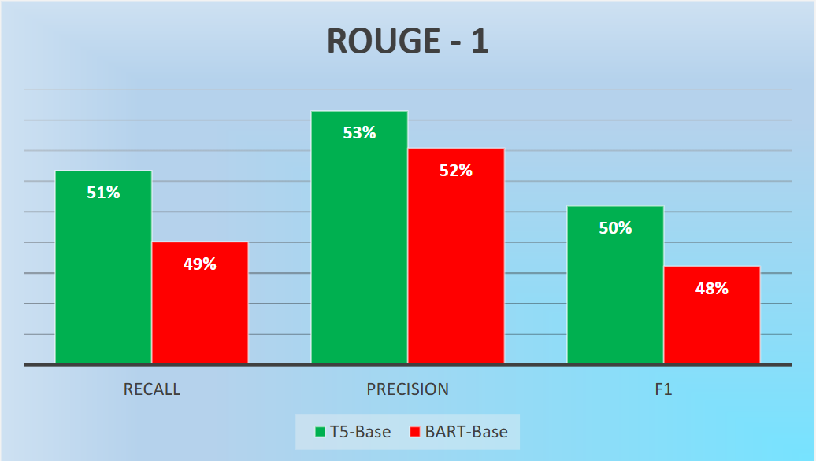
Notes:
After testing the both models, T5-base achieved overall better percentage in all rouge -1…

Slide 10
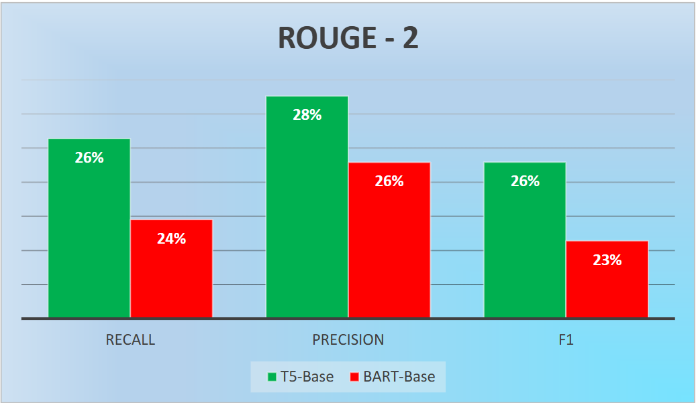
Notes:
rouge -2…

Slide 11
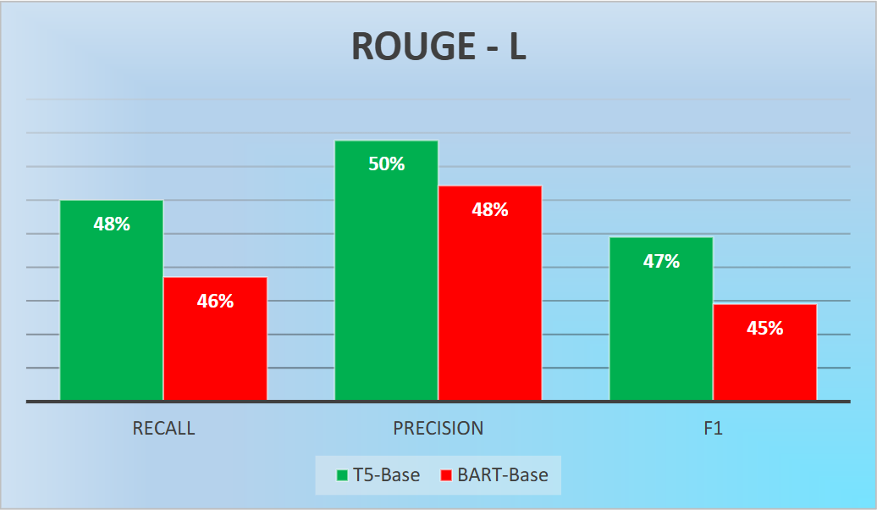
Notes:
and rouge –L than BART-base. Indicating that it was more reliable in generating concise and comprehensive summaries.

Slide 12
Why T5-Base?
Higher F1 Score: T5-base achieved better F1 Score, outperforming Bart-base, indicating better overall accuracy.
Better Precision and Recall: T5-base showed higher precision and recall, making it more reliable in generating concise and comprehensive summaries.
Efficiency: During evaluation, T5-base demonstrated consistent performance across various test cases, aligning with the project’s objectives.
Notes:
And it’s also shows that T5-base showed higher precision and recall than BART.
These factors are influenced my decision to chose T5-Base. T5-base consistently delivered better performance across various test cases while remaining resource-efficient.
Based on these results, I chose T5-base for fine-tuning and integration into the system. Its superior accuracy and reliability made it the best choice for meeting the project’s objectives.

Slide 13
07. Top Level Architecture

Slide 14
Input - User provides news article URL via streamlit interface.
Tools used - Streamlit
Article Extraction - the newspaper3k library fetches title, author, publish date and full text of the article.
Tools used - Newspaper3k
Text Preprocessing - Clean and preprocess the extracted text to remove unnecessary characters and whitespace.
Tools used - Newspaper3k
Pre-processed text is passed to the fine-tuned T5-base model.
Summarization - model generates an abstractive summary using Tokenization and Beam search for optimal summary generation.
Tools used – Transformers, PyTorch
Output – Display Article metadata Generated summary and Original article (optional, in collapsed view).
Tools used - Streamlit
Notes:
In this slide, I will walk you through the top-level architecture of the system, explaining the processes involved and the tools or libraries used at each step.
The system begins with the Input phase, where the user provides a news article URL through a user-friendly interface built using Streamlit.
Next, in the Article Extraction phase, the Newspaper3k library is used to fetch the article’s metadata, such as the title, authors, publish date, and the full text. This library is highly effective in parsing and extracting data from web pages.
Once the article is fetched, it moves to the Text Preprocessing phase. In this step, the text is cleaned and formatted to remove unnecessary characters, whitespace, or other inconsistencies with newspaper3k library. Custom Python functions were also used for this step.
The pre-processed text is then passed to the Summarization phase, where the fine-tuned T5-base model generates the summary. The summarization process leverages Hugging Face Transformers and PyTorch. Techniques like tokenization and beam search are used here to optimize the summary generation process.
Finally, in the Output phase, the system displays the results back to the user via the Streamlit interface. This includes the article metadata, and the generated summary.
Each of these steps is seamlessly integrated to create an efficient pipeline for news article summarization.

Slide 15
08. Timeline
Week(s) | Task(s)
Week 1 | Selected project topic and defined objectives.
Week 2 | Conducted research on summarization techniques and related models.
Week 3 | Evaluated and compared pre-trained models (T5-base and Bart-base).
Week 4 | Pre-processed the SAMSUM dataset for fine-tuning.
Week 5 | Fine-tuned the T5-base model with the SAMSUM dataset.
Week 6 | Tested and validated the fine-tuned model with news articles.
Week 7 | Developed a user interface using Streamlit for summarization.
Week 8 | Integrated the model and user interface into a complete application.
Week 9 | Conducted performance evaluation and refined the model.
Week 10 | Prepared the final presentation slides and demo.
Week 11 | Prepared documentation and report of the project.
Notes:
This slide outlines the timeline of the project, which was completed over 11 weeks.
In week 1 I’ve selected the project topic and defined the objectives. Week 2 was dedicated to researching summarization techniques and related models. Then I started to evaluate the pre-trained models, fine-tuning the model, all the way down to preparing the documentation and report.

Slide 16
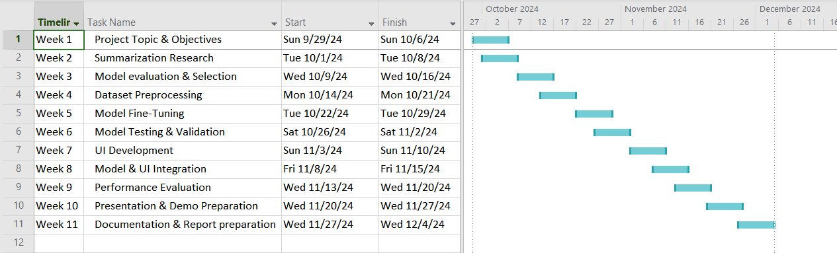
GHANTT CHART
Notes:
This structured timeline ensured the project progressed systematically and stayed on track.

Slide 17
09. Demonstration
Notes:
Now let’s move on to the demonstration. In this demonstration, I will walk you through the implementation and functionality of my news summarization system.
Let's take a look at the code behind this system.
In the beginning I’ve imported the required libraries, then loaded the SAMSUM dataset here with the default splitting of 80:20 ratio. Also loaded the T5-base model here. This process involved splitting the dialogues and summaries into pieces that the model can understand.
This function handles all the training parameters including number of training cycles, batch size and learning rate. Then here the model trained up to 8 times. Also the whole training process managed with PyTorch library.
After the training, the evaluation parameters were defined here to find rouge scores. After the evaluation process, I visualized all the scores in a plot using matplotlib library.
Now let's move on to the interface code. This is built using streamlit. The newspaper3K library fetches news articles from the web with the URL, feeds them to the fine-tuned T5-base model and displays all the generated summaries alongside original articles.
The entire system is hosted on the HuggingFace platform, which means anyone with the internet connection can access and use it.
To give clear idea of how this system works, I’ve selected a few news articles. I’ll feed their URLs into the application one by one.
Now the system is fetching the article from the web. Now it’s generating the summary. Now it’s displaying everything like generated summary and also the metadata like publish date, time and publisher.
Now let’s try with another article. Everything works fine. As you can see how the system fetches the articles, generates summaries and displaying everything in a user-friendly format. I hope this live demonstration clarifies how this news summarization system was built and works.

Slide 18
10. Challenges
Limited Computational Resources: Faced challenges in handling larger models due to hardware constraints, leading to the selection of smaller, more efficient models like T5-base.
Dataset Compatibility: Pre-trained models like T5-base and Bart-base were not originally trained on the SAMSUM dataset, requiring extensive fine-tuning to achieve desired performance.
Error Handling in Article Summarization: Issues in handling poorly formatted or incomplete articles fetched from URLs caused interruptions in the summarization process.
Notes:
Now, I’ll discuss the challenges I faced during this project.
The first challenge was limited computational resources. Larger models often require significant hardware capabilities, which I did not have access to. As a result, I opted for smaller, efficient models like T5-base.
Another challenge was dataset compatibility. The pre-trained models, T5-base and Bart-base, were not originally trained on the SAMSUM dataset. This required extensive fine-tuning to adapt the models to achieve better performance.
Finally, there were challenges related to error handling in article summarization. Poorly formatted or incomplete articles fetched from URLs occasionally caused interruptions in the summarization process.
Despite these challenges, each issue provided an opportunity to learn and improve the system. Next, I’ll share the lessons I’ve learned from this project.

Slide 19
11. Lessons Learned
Model Selection and Fine-tuning: Gained insights into the importance of evaluating multiple models and selecting the one best suited for the project’s objectives.
Efficient Use of Resources: Learned to optimize computational resources by selecting smaller models without compromising performance.
Error Management and Debugging: Improved skills in identifying and resolving errors during model implementation and article summarization.
Notes:
I gained several valuable lessons that enhanced my skills and understanding of text summarization and project development.
Firstly, I learned the importance of model selection and fine-tuning. Evaluating multiple models, showed me how crucial it is to choose a model that aligns with the project’s objectives.
Secondly, I understood how to efficiently use computational resources. Since I had limited hardware capabilities, I optimized my approach by selecting smaller models that delivered high performance without exceeding resource limits.
Another significant lesson was in error management and debugging. Encountering issues during article pre-processing and summarization helped me improve my problem-solving skills and refine the system to handle diverse inputs effectively.
These lessons will be valuable for my future projects, and I’m excited to apply what I’ve learned.

Slide 20
12. Future Direction
Expand to Larger Models: Explore and fine-tune larger pre-trained models like T5-large or Pegasus for potentially better summarization quality.
Support for Multiple Languages: Extend the system to summarize articles in different languages using multilingual models.
Enhanced Dataset Utilization: Incorporate larger and more diverse datasets to improve the model's generalization across various news domains.
Notes:
I also have some potential future directions to enhance this project.
One key area is to expand to larger models, such as T5-large or Pegasus. These models could provide even better summarization quality, although they would require more computational resources.
Another direction is to introduce support for multiple languages. By using multilingual models, the system could summarize news articles in different languages, making it more accessible to a global audience.
Finally, I aim to enhance dataset utilization by incorporating larger and more diverse datasets. This would help improve the model’s generalization across various news domains.
These enhancements would significantly broaden the scope and impact of the project.

Slide 21
13. Conclusion
Successfully developed an automated news article summarization system using a fine-tuned T5-base model.
The project highlights the effectiveness of abstractive summarization in generating concise, human-like summaries.
Demonstrated the practical application of NLP techniques in real-world scenarios.
Overcame challenges such as limited computational resources and dataset compatibility to deliver a functional solution.
Notes:
In conclusion, this project successfully developed an automated news article summarization system using a fine-tuned T5-base model.
The system demonstrates the effectiveness of abstractive summarization in generating concise, human-like summaries, which address the challenges of processing overwhelming influx of digital news content.
This project also highlighted the practical applications of Natural Language Processing techniques, showcasing how they can be used to simplify complex tasks.
Throughout the project, I faced challenges such as limited computational resources and dataset compatibility. However, I was able to overcome these obstacles and deliver a functional and efficient solution.
Overall, the experience was highly educational and provided insights into model development, error handling, and system integration. I believe this project lays a strong foundation for my future works.

Slide 22
12. References
Zhang, H., Xu, J. and Wang, J. (2019). Pretraining-Based Natural Language Generation for Text Summarization. [online] arXiv.org. Available at: https://doi.org/10.48550/arXiv.1902.09243 [Accessed 10 Dec. 2024].
Cheng, J. and Lapata, M. (2016). Neural Summarization by Extracting Sentences and Words. [online] ACLWeb. doi:https://doi.org/10.18653/v1/P16-1046.
Nenkova, A. (2011). Automatic Summarization. Foundations and Trends® in Information Retrieval, 5(2), pp.103–233. doi:https://doi.org/10.1561/1500000015.
Liu, Y. and Lapata, M. (2019). Text Summarization with Pretrained Encoders. [online] arXiv.org. Available at: https://doi.org/10.48550/arXiv.1908.08345 [Accessed 10 Dec. 2024].

Slide 23
Thanks!
Do you have any questions?
Notes:
Thank you all for your time and attention throughout this presentation. and I’m grateful for this opportunity.
I would like to express my sincere gratitude to my supervisor, Mrs. Fathima Sajeetha, my assessor, Mr. Mohamed Nizzad, and thanks for presence of Mr. Nismy, and all the lecturers who have provided invaluable guidance and support throughout my project.
If you have any questions or need further clarification on any aspect of the project, I’d be happy to address them now.
Once again, thank you!

